Slide 1
Clinical Engagement in Product Decision Making
Achieving Value Analysis
Notes:
KY

Slide 2
Thank you for being here and to MAHRMM
Notes:
KY

Slide 3
Who we are
Surgeon Leader who is highly engaged in Value Analysis
Trauma/Acute Care Surgeon
One of 2 AHVAP physician members!
30+ years
System Medical Director (5 Hospital 7 ASC’s)
Surgical Services VAT Chair
Supply Chain Leader who is passionate about product use tells a story about how care is delivered
Sourcing/Value Analysis Professional
Wayne State SCM Board Member
30+ years
System Sourcing/VA Director
Clinical Products VAT Trailblazer
This Photo by Unknown Author is licensed under CC BY-SA
Notes:
KY

Slide 4
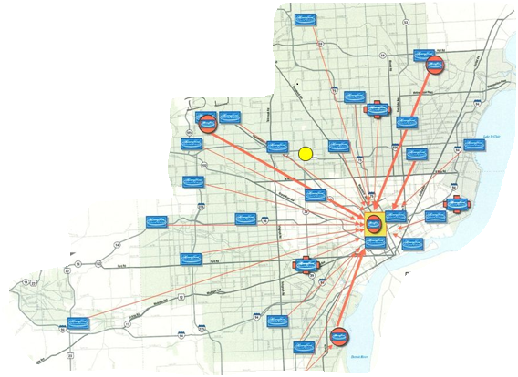
Where are we from – Henry Ford Health
Located in Southeastern Michigan
More than 33,000 Employees
Five Acute Care Hospitals
Henry Ford Hospital (Flagship)
769 bed Quaternary Referral Center, Academic Medical Center & Research Complex
Four Acute-Care Community Hospitals
2 Behavioral Health Residential Sites
200+ Care Delivery Locations
Henry Ford Medical Group
More than 1600 employed multispecialty physicians and researchers
One of the nation’s oldest and largest group practices
Notes:
KY

Slide 5
Destination Grand
Future of Health: Detroit
Notes:
KY

Slide 6
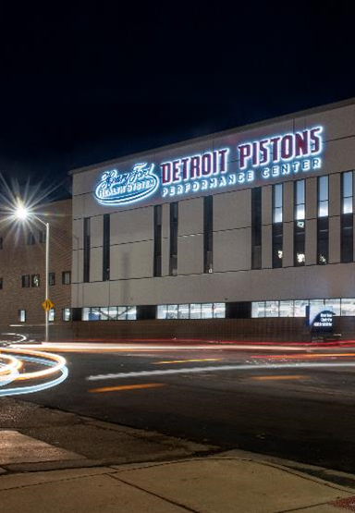
Destination Grand Future of Health: Detroit
Our Partner
Our landscape
New Live and Work
MSU Research
Notes:
KY

Slide 7
Why should we think about Supply Cost Management differently with our Clinicians?
Changing Healthcare Environment
Value-Based Purchasing/Care, Bundled/Prospective Payments, No Margin in Hospitals
Burning platform to control cost
Average Hospital (Non-Pharmacy) Supply Cost: >$60M (40% in the OR)
>60% are Physician Preference Items
Addressing price won’t get us there alone
New Technology out pacing our ability to manage introduction
Change alignment of Physician/Clinical and Vendor
Notes:
KY

Slide 8
Why is Physician Engagement in VA Important?
Payers are already sizing up physicians as well as hospitals, and trying to steer patients to those with the best outcomes at the lowest cost
Without physicians involved in the value analysis process there is a lack of support and unwillingness to champion the decisions that need to be made
You need physicians to get the necessary clinical input (trial data) to make informed decisions: it’s hard to change practice
Engaged physicians seem to have more of an intrinsic motivation. They want to know that they have input into decisions that potentially impact patient care and that their opinions are not only valued but actually utilized
Notes:
PP

Slide 9
Why is Physician Engagement in VA Important?
Notes:
PP

Slide 10
Supply Cost Containment Strategies
Pricing Reduction Strategies
Group Purchasing Coalitions
Value Analysis and Competitive Sourcing
Payment-Cap Models
Standardization Strategies
Formulary Models
Utilization Management/Tiered Contracts
Evidence-Based Practice
Notes:
PP

Slide 11
Supply Cost Containment Strategies
Cheaper Stuff
Group Purchasing Coalitions
Value Analysis and Competitive Sourcing
Payment-Cap Models
Less Stuff
Formulary Models
Utilization Management/Tiered Contracts
Evidence-Based Practice
Notes:
PP

Slide 12
Henry Ford Health Landscape
Henry
Ford
Health
Employed
Medical Group/Academic Faculty
Independent
Both academic and community focused
Incomplete integrated System built from mergers and acquisitions
Different provider and administrative structures with potentially differing priorities (follow the money)
Notes:
KY

Slide 13
What Landscape do you operate in? Does it make a difference if your physicians are employed?
We all have these situations
NO
Notes:
KY
Also in the Lumere study - and I my experience - Employed physicians are not necessarily more likely to make decisions based on hospital cost and preference compared to independent physicians
The vast majority (91%) of surgical and medical specialists believe that increasing physician access to cost data would positively affect care quality, but only 40 percent of physicians report their health systems are working to increase physician access to cost data
Physicians with more exposure to cost data and variation reduction efforts (via years of experience or participation in those efforts) generally find cost data more influential in their clinical decision-making
Data transparency is a strong driver for positively influencing physician behavior

Slide 14
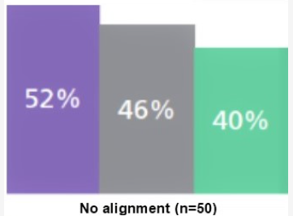
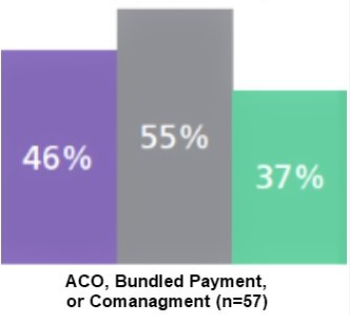
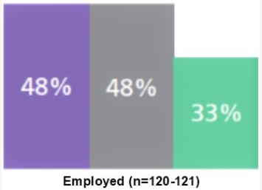
Lumere Study: Physicians Perceptions and Practices 2018
Percentage of surgical specialists reporting information would be “very” or “extremely” influential in their decision to switch medical devices, by alignment model
Notes:
KY
Study by Lumere
276 physicians
19 question Likert-style survey
Sought to uncover the factors that affect physician decision-making — designed to gather insights on physicians’ perceptions of clinical variation, quality improvement strategies, access to clinical outcomes and cost data, involvement in hospital drug and device decision-making, and drivers of drug and device preference

Slide 15
Study Takeaways
The vast majority of (91%) surgical and medical specialists believe that increasing physician access to cost data would positively affect care quality
Physicians with more exposure to cost data and variation reduction efforts generally find cost data more influential in their clinical decision-making
Data transparency is a strong driver for positively influencing physician behavior
Notes:
KY

Slide 16
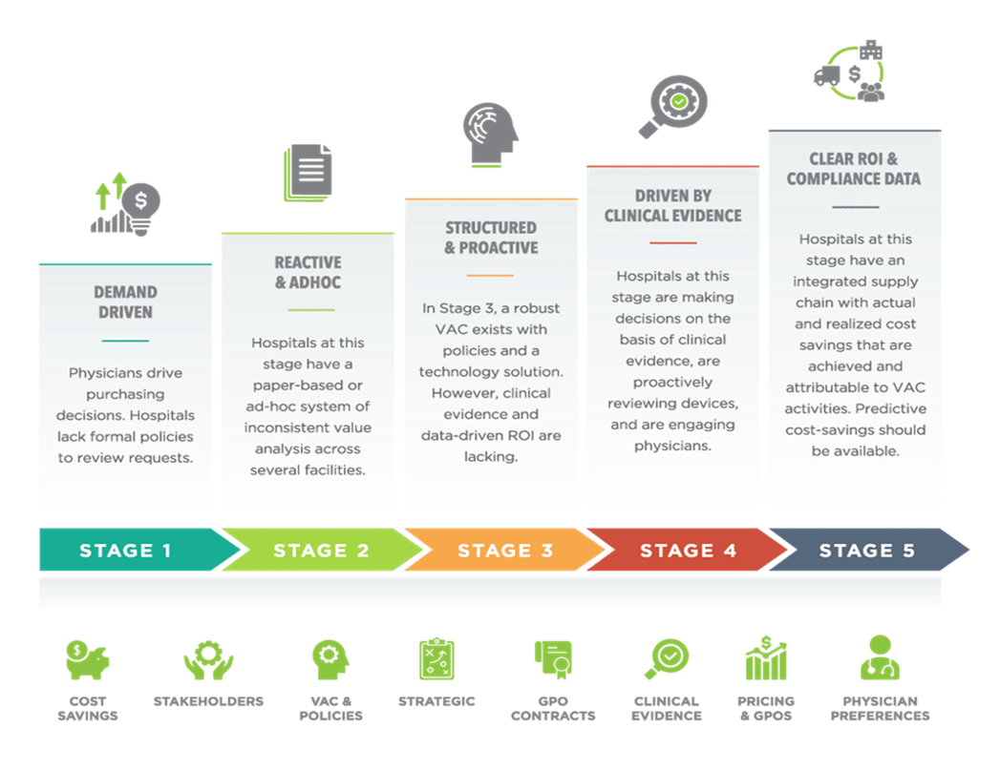
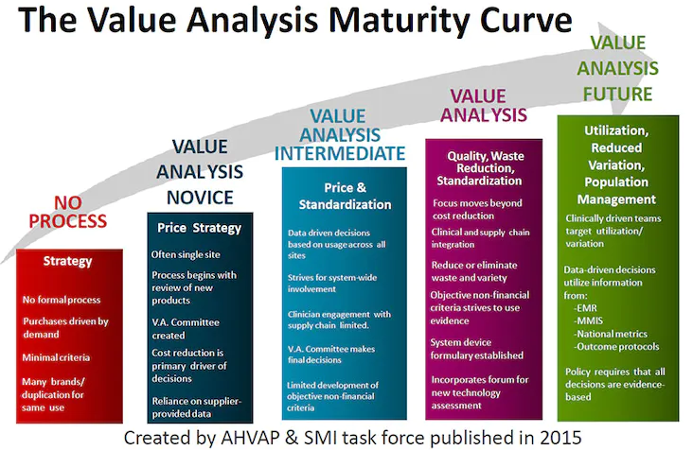
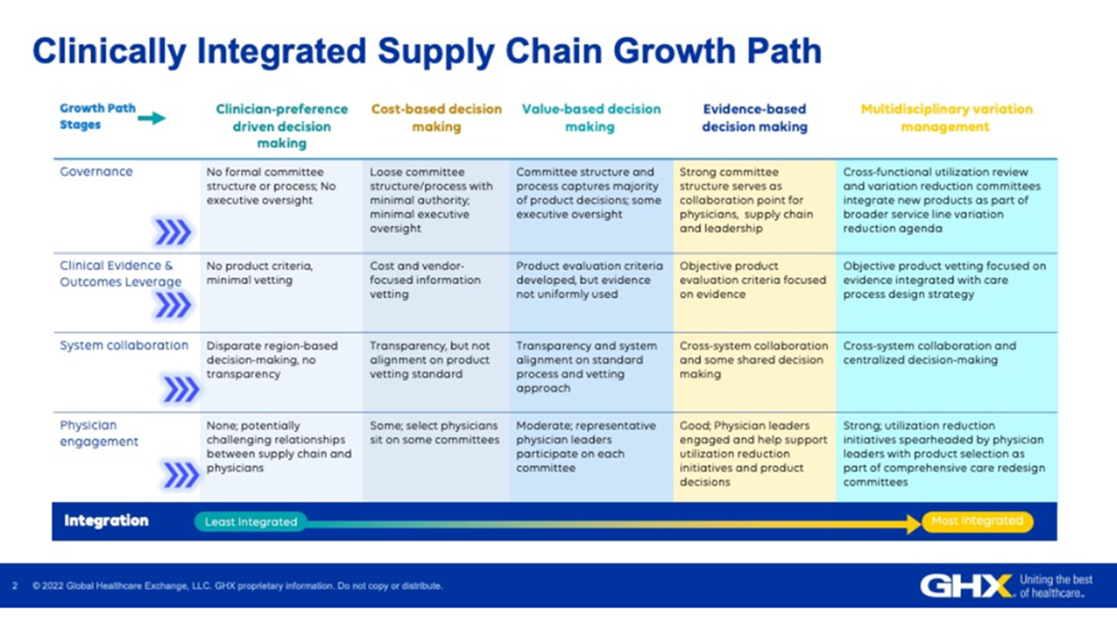
Models of Value Analysis
Notes:
PP

Slide 17
Finding Value
Quality
Outcomes
Value
═
Cost
Notes:
PP

Slide 18
Supply Chain Management Tools Sourcing Value Analysis Data Management
Notes:
KY

Slide 19
Sourcing Organization Chart
Candice Pyltik, Vice President
Kelley Young,
Director Sourcing and Value Analysis
Medical/Surgical Products
Cassandra Washington, Director Sourcing
Purchased Services, IT, Capital Sourcing
Nicholas Woodall, Director Procure to Payment (Purchasing and Accounts Payable)
Susan Huggins – Ortho Joints, CMF, Trauma, Sports Medicine
Jeanette Parent – Neuro/Spine, Opthy, Specialty Urology, ENT Surgical
Jameane Bouie – Anesthesia, Other Specialty Surgical
Aliya Khan – Nursing and Women’s Health
Jeff Doucette – Lab, General Radiology/Imaging, Respiratory
Ashlee Smith – Cardiovascular, Interventional Radiology
Responsible for:
All supply/product contracting
New product process
Value analysis information
Contract compliance monitoring
Addressing product shortages
Facilitating product change implementation
Vendor Management

Slide 20
Sourcing and Value Analysis
Delivery to Stakeholders
Healthcare Stakeholders:
Patients and Providers
Vendors Relationships
Notes:
KY

Slide 21
Processes that work together in Healthcare
Sourcing
Value Analysis
Strategic Sourcing is a process that minimizes supply risk across the procurement process by improving supplier selection and providing better visibility into purchasing data and forecasting.
A Systematic process to review clinical products, equipment and technologies to evaluate their clinical efficacy, safety and impact on organizational resources.
Source: Association healthcare Value Analysis Professionals
Notes:
KY

Slide 22
Value Analysis Team Responsibilities
COMPLIANCE – monitor, communication, change agents
Contractual
SRT Initiatives (Utilization Changes)
PRODUCT DECISIONS – vetting, communication, change agents
New Product Introduction
Product Changes due to market conditions, conversions, contractual
Utilization/Standardization – overall supply cost per case
Supply cost per product, as a set of products for a case, usage of products in procedures
Operational efficiency and effectiveness
Notes:
KY

Slide 23
Value Analysis System Charter Guidelines
Notes:
KY

Slide 24
Value Analysis Teams – HFH Charter
Perform the functions of VAT with an existing Team or create a specific VAT
VAT Objectives accomplished with multi-disciplinary teams owned by clinical and administrative leaders with Supply Chain Management
Each VAT adopts the system charter guidelines
VAT Charter includes conflict of interest disclosure requirements
Notes:
KY

Slide 25
VAT Structure
Henry Ford Health VATs are subcommittees of a System Clinical Councils at the Service Line or Department level and represent all operating units – inpatient and outpatient.
Decisions are made by interdisciplinary team members and driven by data and overall value delivered to all operating units
Membership guidelines:
Physician or clinical executive chair/co-chair(s)
Representation of physician sub-specialties (employed and independent)
Medical and other clinician leaders
Supporting membership: Supply Chain Management, Finance, other administrative areas – Preference Card, Billing, etc.
Ad hoc membership as required, such as infection control, rehab, etc.
Notes:
KY

Slide 26
Supply Chain Roles
Today, no formal “Value Analysis” or “Clinical Resource” Manager Roles are in place at HFH
Sourcing Managers support Value Analysis Teams today
The most successful value driven supply chains will have Sourcing and Value Analysis staff:
Working Together
Exchanging Hats
Data Driven
Able to drive and lead change
The ultimate model is to have Clinicians and a Medical Director on staff
Most fill these roles through relationships
Notes:
KY

Slide 27
Engagement Model for the Clinicians/Physicians
Requires input from Physicians | Requires direction setting and final approval from Physicians
Requires little input or feedback from Physicians | Requires feedback from physicians for acceptance
High
Project Value and Complexity
Low
High
Amount of Decision Making
Notes:
KY

Slide 28
Our VAT Functions are in alignment with benefits of physician leadership
Increase clinician awareness and accountability for clinical supply (product) costs
Providing a forum for review and approval of new product requests
Facilitate development of a “System-wide” mindset
Improve quality by establishing system-wide best practices in clinical supply utilization
Provide communication structure for conversions/information to operating units
Monitor and maintain contract commitments, and utilization compliance
Identify improvements in processes to reduce overall supply cost per patient case
Notes:
KY

Slide 29
New Product Request
Must Identify a Clinician/Physician Champion
Information provided and vetted by clinicians, supply chain and finance
Notes:
KY

Slide 30
New Product Request
New product requests are entered into Enterprise System (Lumere) by the requesting user. The clinical originator of the new request is the advocate/champion for the product at the VAT meeting. Supply Chain Management and Finance works with the new request champion prior to the meeting to provide the following information for discussion and voting:
Clinical Product Synopsis
Product Description
Product Manufacturer
Clinical Justification
Replaces or Enhancement
Supply Chain Analysis
Competitive Product
Price
Projected Annual Usage
Contract Terms
Financial Synopsis
CPT Codes
Average Reimbursement
Average Cost
Average Contribution Margin
Notes:
KY

Slide 31
Stakeholders
Who’s at the Round Table and Why?
Notes:
PP

Slide 32
Key Stakeholder Roles
Value Analysis Program
(Review & Evaluation)
Physicians/ Clinicians
(Product Knowledge and Evaluation)
Finance
(Cost-Benefit Analysis)
Supply Chain
(Vendor Management, Contracting Knowledge)
Notes:
PP

Slide 33
Voices for their stakeholders
Wants to have a stake in decisions
Rather be part of the process than being told how to practice
May or may not share institutional commitment
Needs to hear “administrators” perspectives
Need to be present for clinical adjudication/evaluation
Peer-to-Peer buffer/liaison
Physician Team Member
Notes:
PP

Slide 34
Voices for their stakeholders
Control supply costs
Control inventory/standardize
Contractual compliance
Charge capture
Timely approval and access to new product/technology
Alignment of physician needs, Supply Chain goals, and innovation
Communication and transparency between Supply Chain and clinicians
The Supply Chain Member
Notes:
PP

Slide 35
Voices for their stakeholders
Find a profit/Control Costs
Needs to see data
Need to have input
They can’t be seen as decision makers
Finance Team Member
Notes:
PP

Slide 36
The Team
Identify Leaders, Champions, SMEs, Influencers and Stakeholders
Don’t forget support staff
Utilize Subcommittees
Service-line focus
Procedure focus
Product Category focus
Leverage Peer-to-Peer Interactions
Notes:
PP

Slide 37
Data and Business Intelligence
Notes:
KY

Slide 38
“Products tells a story about care delivery.”
Critical to understand your information systems and sources of data
Focus on getting it right the first time
Notes:
KY

Slide 39
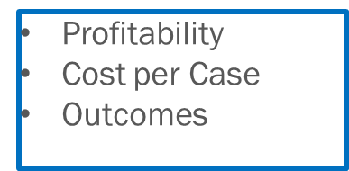
Meaningful Data Sources
Patient Discharge
All Payor Data
Patient Bill Data
INFORMATION
Spend
Market Share
Acquisition Cost
Supply Cost File
Closed Receipt File
Surgical Data
Procedure Log
Implant Log
Procedure Time
Products
Utilization Qty
OR/Procedural Data
LOS
Readmissions
HAI Rates
HCAPS
Quality Data
Infection Control Data
Patient Experience
Quality Data
Notes:
PP

Slide 40
Data, Data, Data
Align physicians around data that is reliable and actionable
Give physicians peer-to-peer comparisons of their performance
Combine cost and clinical data around procedure profiles that clinicians can both understand and act on
Teams can use existing service line structures or create multidisciplinary councils to establish trust and drive change around the data
Notes:
PP

Slide 41
Engaging Physicians in the VA Process
Notes:
PP

Slide 42
Where do the physicians play a role in VA?
On the Value Analysis Team
In the Care delivery areas
Notes:
PP

Slide 43
Starting the value conversation
Physicians need to be “at the table” and part of the process
“Nothing about me, without me”
Show physicians the data
Be transparent about where it came from, how it was collected and how you are reporting it
Come at this from a quality perspective
Driving efficiencies in care delivery and elimination of waste
Allow the cost discussion to develop naturally as a byproduct of reducing variation, improved performance and patient outcomes
What’s best for the patient is ultimately what’s best for the hospital and health system
Notes:
PP

Slide 44
What types of Physicians do you look for?
Surgeon =
Scientist, Perfectionist, Competitor
Listening
Learning mindset
Data oriented
Project Management
Notes:
PP

Slide 45
Know Your Docs
https://www.youtube.com/@DGlaucomflecken
Notes:
PP

Slide 46
How you can help the docs be successful
Well defined, consistent processes
Acknowledgement of time commitment
Off hours scheduling
Ease of access for requests
Single sign-in, mobile
Deference to expertise
System-wide communication/transparency
Notes:
PP

Slide 47
Communication
Face-to-Face Meeting with physicians and Supply Chain
Mass email communication
Agenda item on service-line meeting
Departmental staff meetings
Notes:
PP

Slide 48
Words of Wisdom
Come to the conversation confident and prepared
Vetted Literature
User Experience
Appropriate Financials
Ask for evidence, don’t necessarily provide evidence
Never let the first conversation be the worst conversation
Don’t be afraid of data challenges
Give them something to respond to, then listen to what they have to say
Notes:
PP

Slide 49
Words of Caution
Never lead with cost
Don’t patronize or BS
Recognize potential outside influences and biases
Beware supplier crosses
Spend data vs Usage data
Notes:
PP

Slide 50
Dealing with the Difficult Surgeon (Physician)
Notes:
PP

Slide 51
Emotional Intelligence: Why are they so Difficult?
Desired autonomy
Perceived dependency
Varying degrees of institutional commitment
Time commitments
Financial disconnects: knowledge and cost over quality
Feel Disenfranchised: Decision-making appears to lack SME adjudication
Inadequate product equivalency data
Lack of understanding/transparency
Lack of Peer-to-Peer Interactions
Notes:
PP

Slide 52
Change Management/Conversions
Barriers to Change
My Patients come first
How I Learned to do it
My Technical Comfort/Expertise is Important
My Outcomes???
Notes:
PP

Slide 53
Inevitable Pitfalls
Delays or prolonged decision making will lead to frustration
Beware stakeholders working outside of the VA process
Vendors circumventing the process to get product into the system
BEWARE MAKING EXCEPTIONS
Notes:
PP

Slide 54
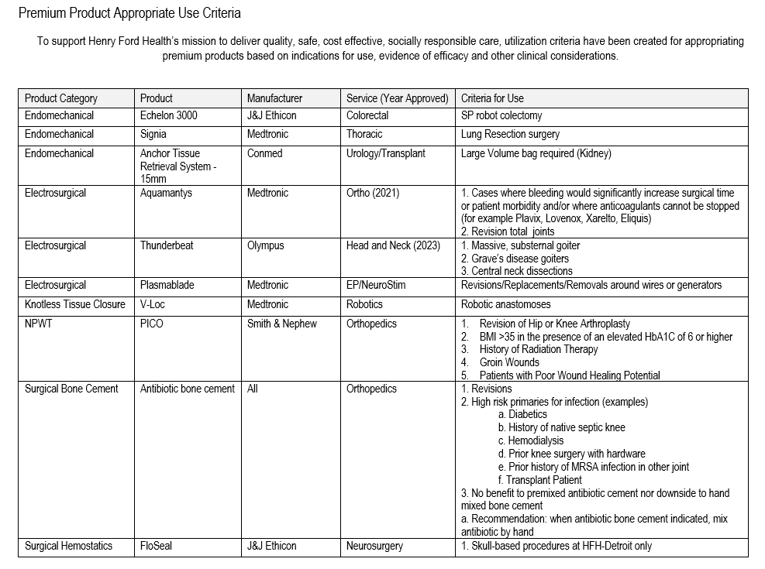
The Exception List: What they need, when they need it
Product
Service
Appropriate Use Criteria (AUC)
Location
Inventory Control
Ordering Controls
Sequestering
Notes:
PP

Slide 55
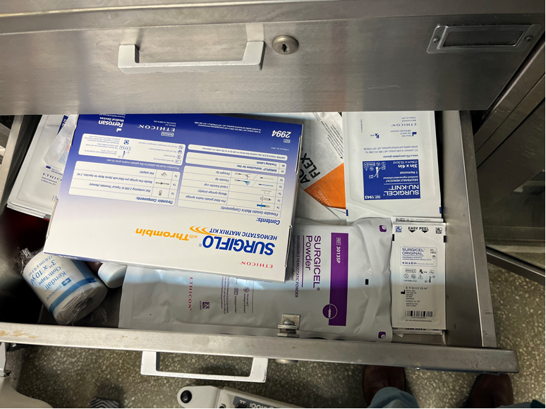
Beyond the VAT: Engaging the Masses
Is your team ready for VA in the OR?
How engaged is the team? (Docs, Nurses, SCM)
Does the team have the right tools?
Are the tools being used?
Are the needed supplies available?
How do you introduce new products? Do people know the process?
Notes:
PP

Slide 56
Our Providers of Care
When interacting with our Stakeholders it is always a balance of Cost and Quality. . .
And Preference
Bringing it all together is putting the patient at the center
Notes:
KY

Slide 57
Engaged Physicians with Supply Chain Management Contribution
Notes:
KY

Slide 58
We appreciate all you do
Notes:
KY

